Slide 1
Customer Retention
A Case Study – Indian E-commerce

Slide 2
What are the main characteristics which will influence customer retention?

Slide 3
This study provides an insight into what the data analysis process is and how to analyse the data with visualization. Set up : I am using pandas, Numpy, seaborn matplotlib for this analysis. Data : The data is collected from the Indian online shoppers. And it has 71 columns and 269 rows. Data cleaning : Here are some of the steps followed to clean the data - Null values- this data has 0 Null values. Duplicates – The data shows 60 duplicate rows, but these can be ignored as one respondant’s response can match to the other. Almost every row has a unique value, There are object and integer datatypes.

Slide 4
Data Analysis 1) Most of the respondant’s aged between 21-40 years old. 2) Most of them have been shopping online for 2 or more years. 3) Most of the respondants’ have shopped less than 10 times a year. 4) They use search engine and app to visit the online retail store. 5) Most of them explore only for 6– 15 mins to make a decision on a particular product. 6) Most of them agree to abandon the shopping cart more frequently. 7) Most of them agree to have early content on the website.

Slide 5
8) Most of them agree on getting more option to compare similar products, getting a good offer, seller’s trust, display the information about the project and seller. 9) Most of them agree to get warranty, return and refund policy. 10) Most of the respondants have shopped from amazon, flipkart and myntra. 11) Most of the respondant’s think that amazon and flipkart have more visual appealing of the web page layout, product offers and a description of information. 12) Most of them think Amazon is a more reliable app and has fast delivery and quickness to complete the purchase, security of financial information, trustworthiness.

Slide 6
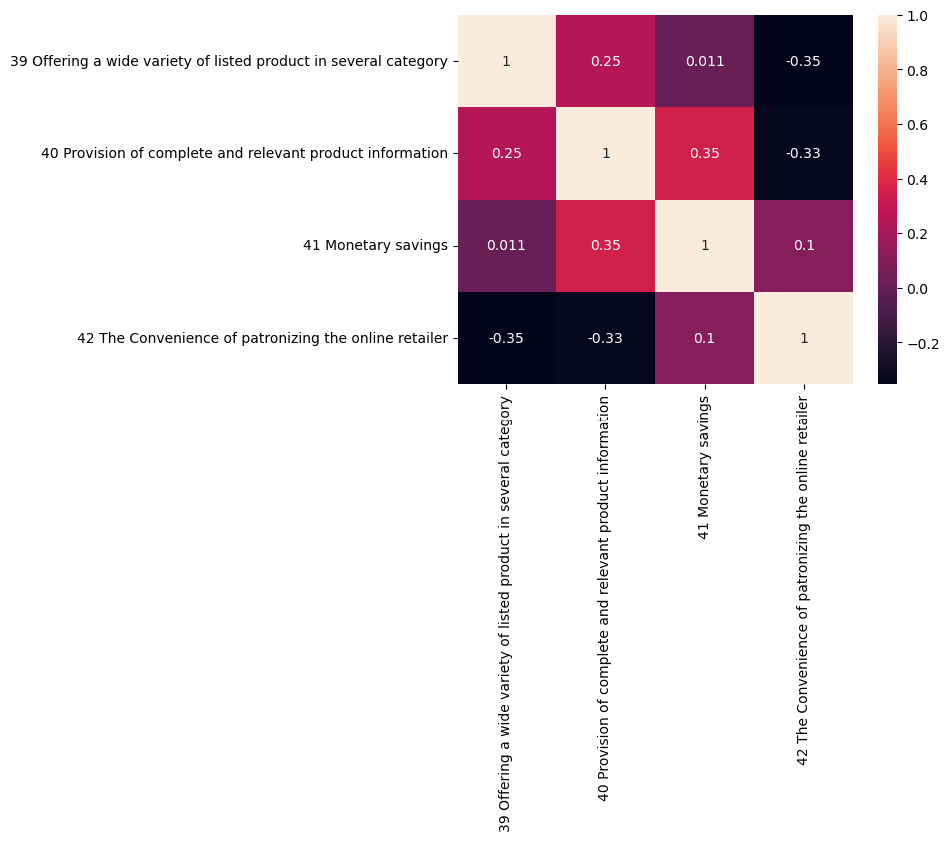
Data Visualization
The above correlation plot is of Utilitarian values- We can clearly see that number 39 is negatively corelated with number 42, and number 41 is positively corelated with number 40.

Slide 7
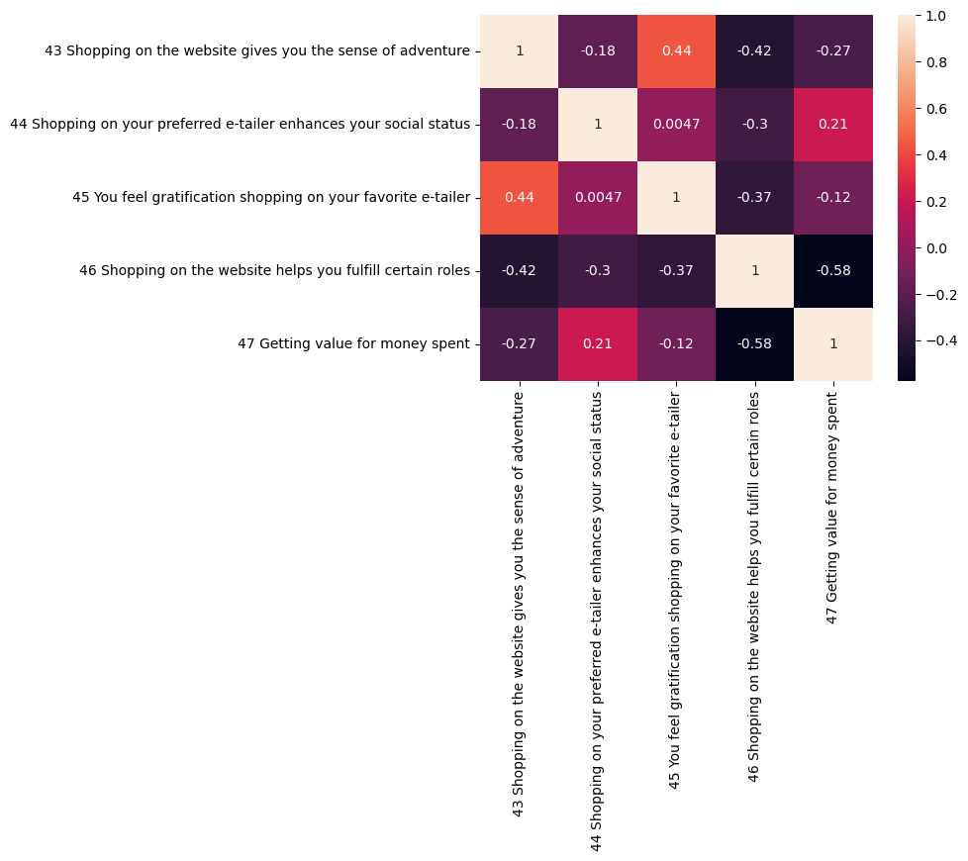
Data Visualization –Hedonic Values
As we can see many negatively correlated values eg number 47 is negatively correlated with number 46 whereas number 45 is positively correlated with number 43.

Slide 8
However, we also perceive that Amazon Flipkart takes longer time to load the graphics, Amazon takes a longer time to get logged on, Myntra takes longer page loading time. Snapdeal has a limited mode of payment on products. Most of them recommend amazon and Flipkart to a friend. After exploring the data, we can conclude that, a balance of both utilitarian and Hedonic values are preferred to retain the customers. However, we can see the hint of inclination towards utilitarian values more than hedonic values. Data set is too small to make too prominent decisions.

